Slide 1
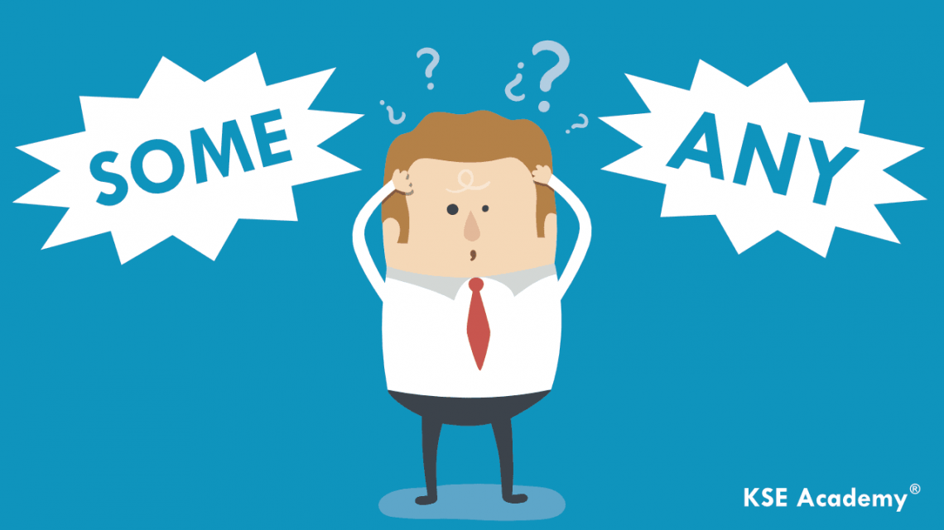
Notes Some & Any

Slide 2
Some
Een paar, enkele, wat
Bevestigende zinnen
Vraagzin waarin je “ja” als antwoord verwacht
Wanneer je iemand iets aanbiedt
I know someone who can help you.
Would you like something to drink?
Someone = iemand
Somebody = iemand
Something = iets
Somewhere = ergens

Slide 3
Any
Een paar, enkele, wat
In vraagzinnen
In ontkenningen
In bevestigende zinnen waar een ontkennend woord in zit (without, hardly, never)
Do you have any questions?
I won’t tell anyone your secret.
We arrived without any delay.
Anyone = iemand
Anybody = iemand
Anything = iets
Anywhere = ergens

Slide 4
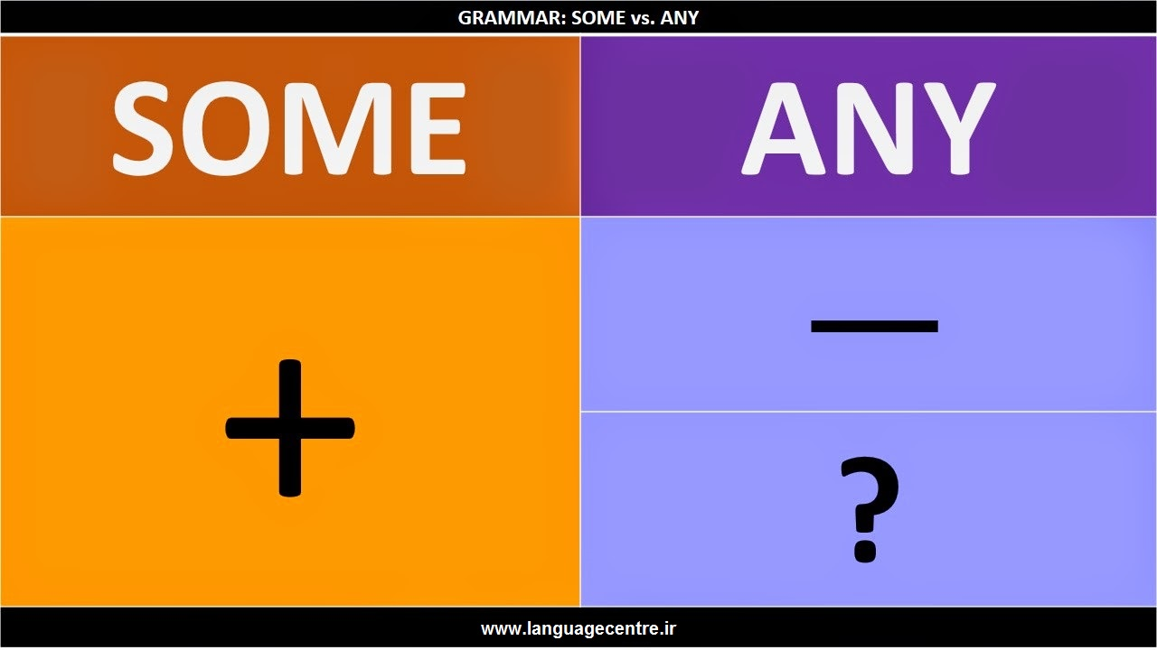

Slide 5



Notes
Some (-thing, -body, -one, -where)
bevestigende zinnen - I have to tell you something.
vragen waarop je “ja” verwacht – Could I have some milk, please?
als je iets aanbiedt - Would you like some tea?
Any (-thing, -body, -one, -where)
ontkennende zinnen - I won’t tell anytone.
alle andere vraagzinnen – Is anyone home?
bevestigende zinnen met ontkennende woorden (never, without, hardly) - There were hardly any people.

Slide 6
Engels woord | Some (-thing, -body, -one, -where) | Any (-thing, -body, -one, -where)
Gebruiken bij | bevestigende zinnen I Have to tell you something important. | ontkennende zinnen I don’t know anyone who speaks French.
Gebruiken bij | vragen waarop je “ja” verwacht Can somebody help me, please? | alle andere vraagzinnen Do you see her anywhere?
Gebruiken bij | als je iets aanbiedt Would you like some tea? | bevestigende zinnen met ontkennende woorden (never, without, hardly) There were hardly any people.

Slide 7

Are these sentences correct?
Please, say something!
Stay put, don’t go somewhere.
I don’t know anything about science.
My cats don’t listen to someone
Anyone must have taken my umbrella.
Does someone here speak Japanese?

